Slide 1
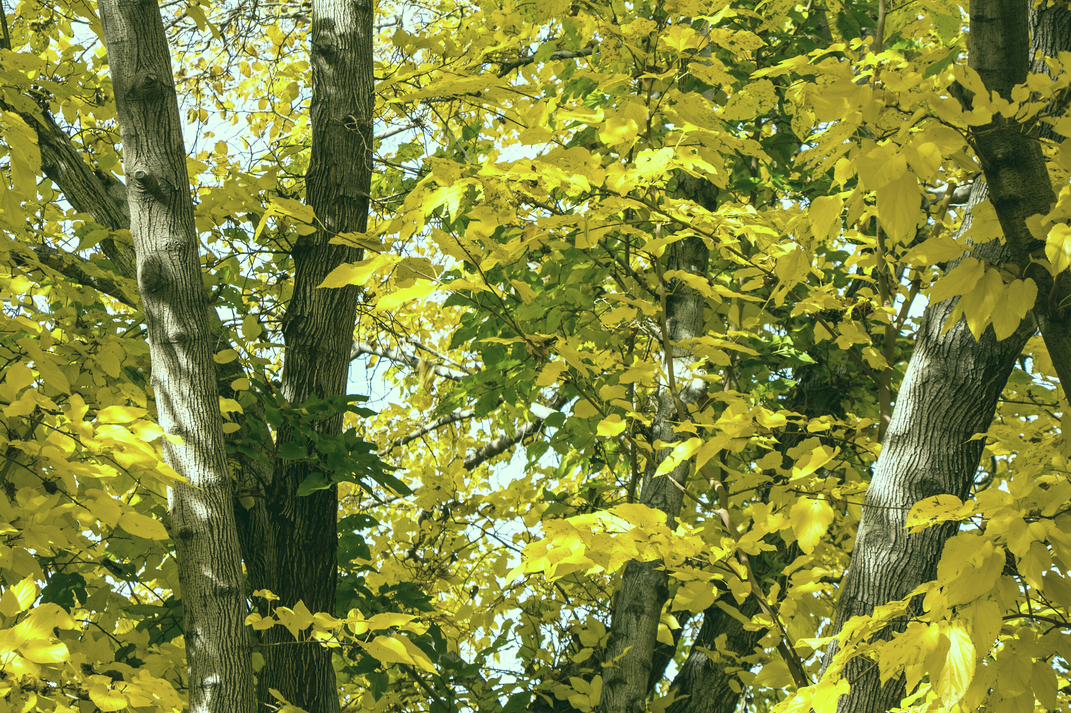


Shooting Stars
Category: Software
Ministry name: Amazon Web Services
Problem Statement: AgriTech: Stubble aggregation and disposal
Problem Code: AN316
Team Leader Name: Shriyansh Jain

Slide 2

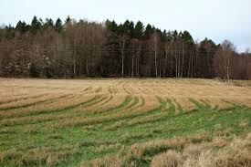
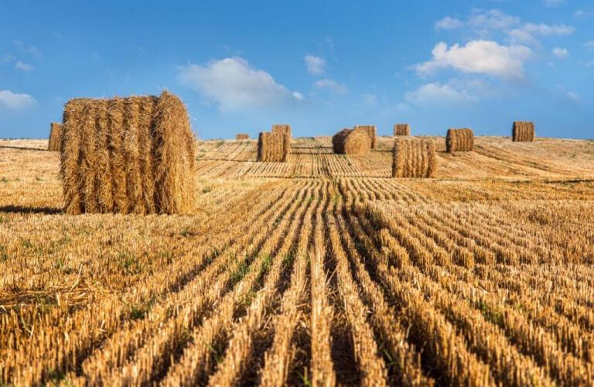
What is Stubble?
Stubble is defined as the crop residue left in the field after harvest, including stem, leaf and glumes of cereals etc.

Slide 3
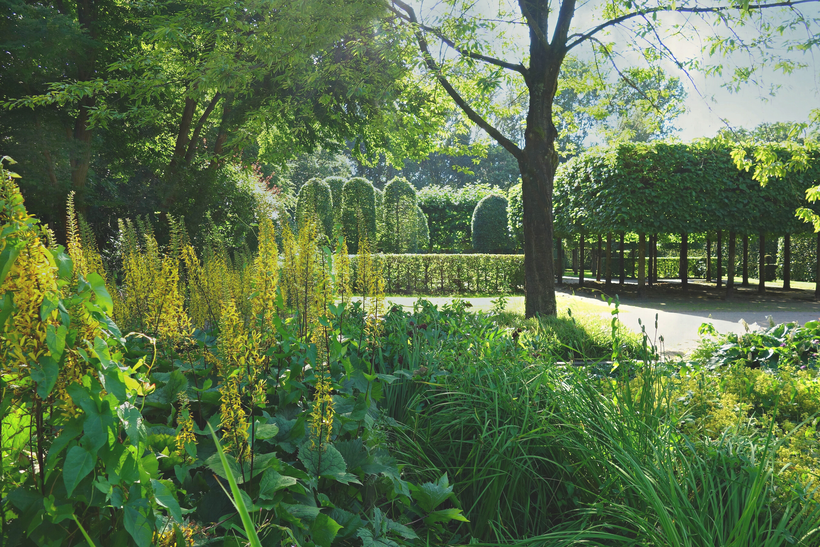

Burning of rice straw remains emits trace gases like carbon dioxide, methane, carbon monoxide, and large amount of particulate matters, which adversely affect human health as well as the environment.
The problem has aggravated air pollution in Delhi and surrounding cities to alarming levels along with construction dusts and high traffic. The problem compounds with the onset of fog in winters in North India. This is because fog in combination with smoke forms smog which rests near the ground and cause various problems like breathing issues aggravating asthma, lack of visibility leading to high number of accidents on roads.
Apart from pollution, burning can reduce soil quality and make land more susceptible to erosion. The problem has become grave because despite it being banned by state governments like Punjab Pollution Control Board and other penalty measures like imposing hefty penalty the farmers are still continuing with the practice.
The Problem

Slide 4

Progressive Web Application:
Helps the farmers to predict the amount of stubble produced by entering the area of land and crop sown earlier. This data would be useful for the businesses to look out for potential sellers. The purpose of identifying and focussing on the largest producers of stubble would be met.
User friendly Interface:
Web and mobile app with extremely simple interface to ensure ease of operation by farmers and making it bilingual to ensure easy access to farmers who are well versed with Hindi.
Benefit to Businesses:
In the straw collection process, the presence of large and continuous fields is necessary to avoid wasted resources. To tackle this issue, we use web mapping APIs to extract field images and analyze them using unsupervised machine learning techniques to segregate dense continuous paddy fields from the other crops
Our Solution

Slide 5
Setting up Warehouses:
The collected stubble needs to be transported to the warehouse within a couple dozen days. We built a machine learning model to recommend the optimal location for each warehouse, helping us significantly reduce our costs.
Weather Alerts:
Farmer might want to know tomorrow 's weather. Our proposed idea will use weather API for providing information about the next 5 days' weather to the farmer.
Tracking Paddy Straw Fires:
We use satellite data from one of the largest aeronautics and aerospace research agencies to track open field paddy straw burning.
Our Solution

Slide 6

Workflow and Architecture
Stores the JSON data obtained from the data scraper script and creates a noSQL database
ML Child Process
API would send notifications to mobile phones by SMS
Database
SMS API
Insert the result for various task
Provide input to ML models
Backend API
Desktop App
Mobile App
Web App
Similar to web app
Similar to web app

Slide 7

Use Cases
Get prediction for earning
Place order
Get prediction for stubble production
Payment handler
Login
Login
Weather alerts
Login
Manage certifications
Buyer
Logistics
Farmer
Delivers order
Manage farms
Pickup Order
Deliver to warehouse
Will get efficient transport routes
Payment handler
Has order limit
Warehouse
Place order
Personal use
Admin
Provide machinery
Commercial use
Manage all entities
Get notification for stubble burning

Slide 8
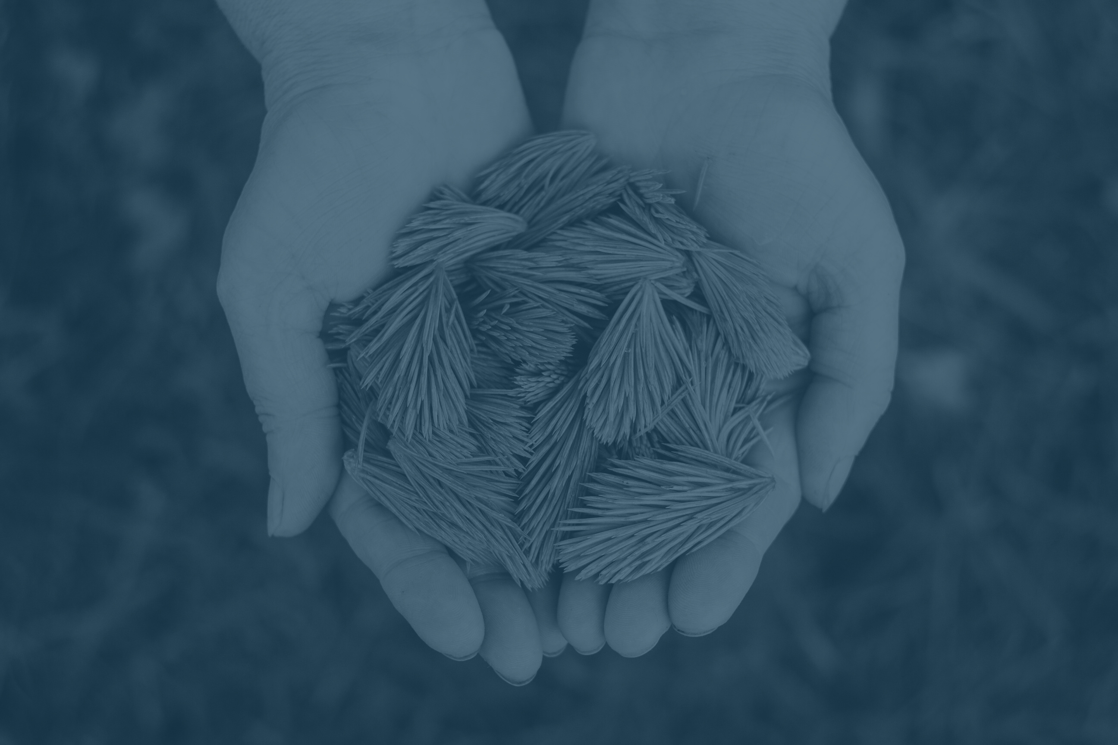
Business Model
Accepting Orders:
We will be accepting orders 1 month prior to the harvesting period. If the order is of large quantity i.e. more than 25kg ,then the buyer has to submit a certification stating the purpose of utilization. This will ensure the proper use/disposal of the stubble.
Hub- Spoke Model:
To reduce the transportation cost , we will find optimal location using ML unsupervised algorithms and setup warehouses at these locations.
Price Estimation:
Mainly the stubble is used for paper production, energy generation, as coal and as biogas. Depending upon the usecase of the buyer we will use supervised models to predict the selling price for stubble.
Provide Machinery:
We will provide farmers with Happy Seeder and Paddy Straw Chopper machines so as to facilitate the process of cutting the stubble.

Slide 9

Technology Stack and Dependencies
Web App
Server for Backend API: node.js
Frontend: HTML/ CSS/ Materialize/ React
Database: MongoDB
Authentication: Json webtoken
Deployment: AWS/ DigitalOcean
Machine Learning
OpenCV, Pytorch, Scikit-Learn, adaBoost Classifier, Decision tree, CNN
Mobile Apps
Android and ios: React Native
Desktop Apps
Windows and MacOS: Electron

